Slide 1


June 3rd, 2025
1:00pm – 4:00pm
Oregon Conservation and Recreation Fund
Advisory Committee Meeting
Virtual Meeting

Slide 2
Agenda Item 1:
Review and Approve Meeting Minutes
(May 6th 2025)

Slide 3
Draft Motion Templates re: Minutes
I move to approve the May 6th, 2025 meeting minutes with the continued authority to correct spelling, grammar, and punctuation.
I move to approve the May 6th, 2025 meeting minutes with the addition/correction/ deletion of ____ on page ___, line ____, and continued authority to correct spelling, grammar, and punctuation.

Slide 4
Agenda Item 2:
OCRF Project Presentation
Northeast Oregon Highway 82 Wildlife Crossing Project
Tim Greseth, Oregon Wildlife Foundation and Colin Reynolds, Defenders of Wildlife.

Slide 5
Agenda Item 3:
OCRF Project Presentation
The Audible Bats project
Sara Rose, Northwest Bat Hub, OSU Cascades

Slide 6
Agenda Item 4:
Public Comment

Slide 7
Agenda Item 5:
Break
(Please be back in 10 min)

Slide 8
Agenda Item 6:
OCRF Communications Planning Update

Slide 9

Quinn Thomas Update 6/3/2025
social graphic announcement (FB, IG, Twitter)
OCRF grantee questionnaire sent out to collect stories
OCRF messaging - finalized
In progress: - legislator letter and social media templates
Reviewed grantee reporting process
updating grantee toolkit

Slide 10
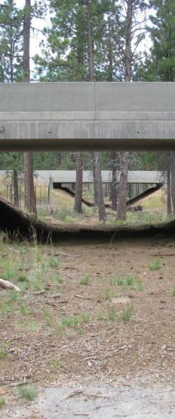
Agenda Item 7:
OCRF Business Items

Slide 11
OCRF Spring 2025 RFP - Timeline
Request for Proposals (RFP) – Open March 20th, 2025
Official RFP Guidance made public (open for 50 days)
Request for Proposals (RFP) – Close May 9th, 2025
Technical Review Period – May 20th - June 23rd, 2025
OCRF Advisory Committee Review Period – June 17th - July 15th, 2025
(Release early – more lead time)
OCRF Advisory Member follow-ups w/ tech reviewers – July 9th – 11th
Opportunity for OCRF Advisory Members to have Q/A with the ODFW technical reviews on an as needed basis
OCRF Advisory Committee Recommendations – July 29th, 2025 meeting
ODFW Commission Voting – September 12, 2025
Release of funds following contracting process – November 2025
101 applications!

Slide 12
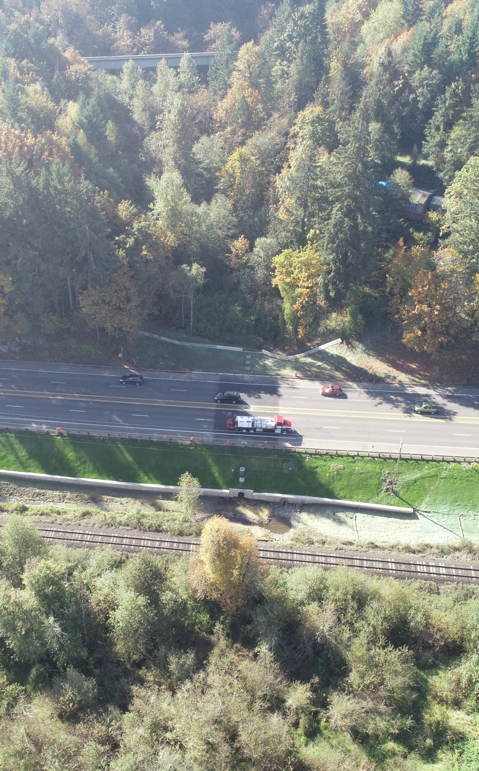
Wildlife Crossing Projects
June 13th : ODFW takes the OCRF Advisory Committee recommended Wildlife Crossing projects to the ODFW Commission for approval
Cackler Marsh, USFWS
Replacement of undersized culvert with 60’ clear span bridge
Restores native floodplain, provides passage for wildlife under main access road in Baskett Slough NWR
I-5 Mt. Ashland Exit, OWF
Installation of retaining wall, backfill, and native vegetation
Expected to significantly improve wildlife passage under existing bridge
Notes:
The first is a project headed by the US Fish and Wildlife Service at Cackler Marsh, located within Baskett Slough National Wildlife Refuge, and will replace an existing, undersized culvert with a 60-foot clear-span bridge, opening up passage for a diversity of fish and wildlife species under one of Baskett Slough’s main access road. This bridge installation is part of a larger effort to restore native floodplain dynamics within Baskett Slough and is expected to benefit species such as beaver and northwestern pond turtle.
The second project is an effort by the Oregon Wildlife Foundation and Southern Oregon Wildlife Crossing Coalition to significantly improve wildlife passage under I-5 at the Mt. Ashland exit. This project will construct a retaining wall that will provide a flat pathway or “bench” for wildlife under the bridge, away from the roadway. Native vegetation planted alongside the bench will help obscure the view of passing traffic, as well as dampen noise, light, and sound, to encourage wildlife to cross under the bridge. Black-tailed deer will benefit from this effort, and the group helps that modifications may also increase the diversity of species that pass at this site.

Slide 13
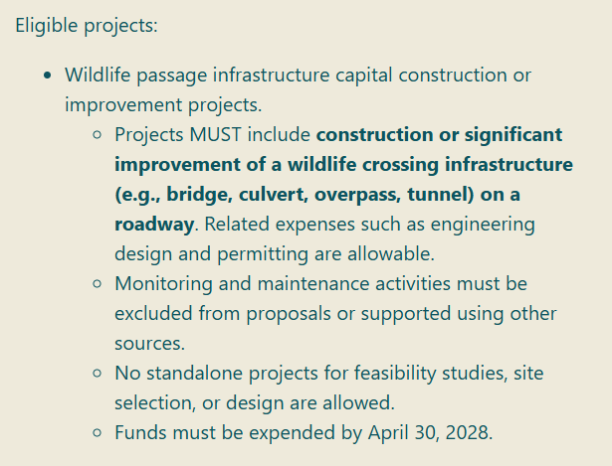
Wildlife Crossing Funds: Second RFI release
Accepting Letters of Interest until July 11th
Please share with your networks. Thank you!

Slide 14
Upcoming meetings
Next Meeting: July 29th
In-Person Meeting: July 28th - 29th
^{(Location: Sisters, OR)}
Site Visit: July 28th , 6pm committee dinner
Committee Meeting: July 29th 9:30 AM – 12:30 PM

Slide 15
Agenda Item 8:
Meeting Wrap Up and Next Steps

