Slide 1


June 5th, 2023
1:00pm – 3:30pm
Oregon Conservation and Recreation Fund
Advisory Committee Meeting
Virtual Meeting

Slide 2
Agenda Item 1:
Review and Approve Meeting Minutes
(May 1st, 2023)

Slide 3
Draft Motion Templates re: Minutes
I move to approve the May 1st, 2023 meeting minutes with the continued authority to correct spelling, grammar, and punctuation.
I move to approve the May 1st, 2023 meeting minutes with the addition/correction/ deletion of ____ on page ___, line ____, and continued authority to correct spelling, grammar, and punctuation.

Slide 4
Agenda Item 2:
Selection of Recommended Projects

Slide 5
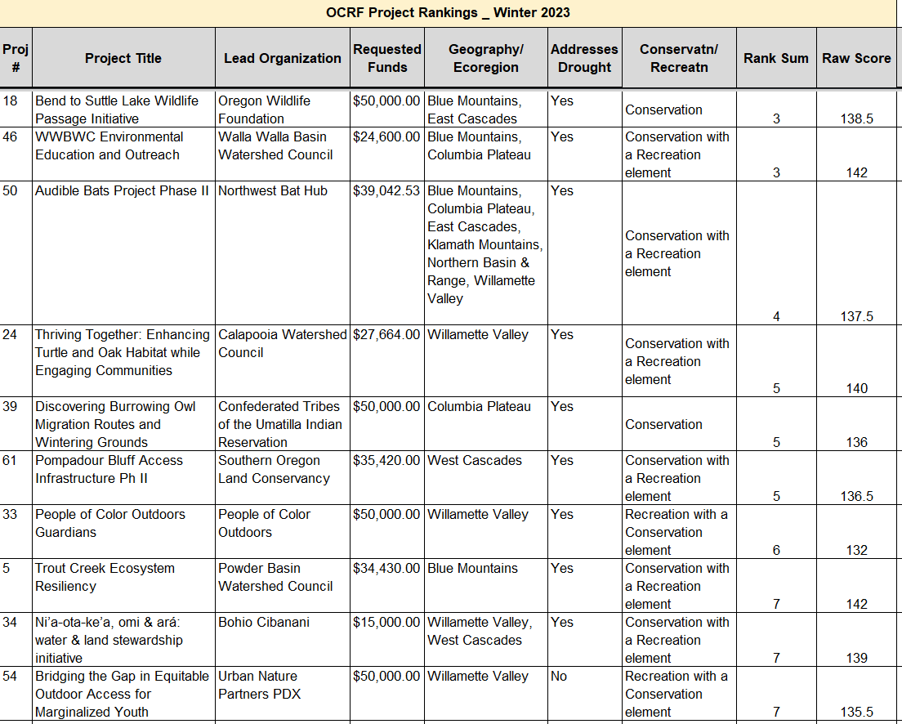
Top 10 ranked

Slide 6
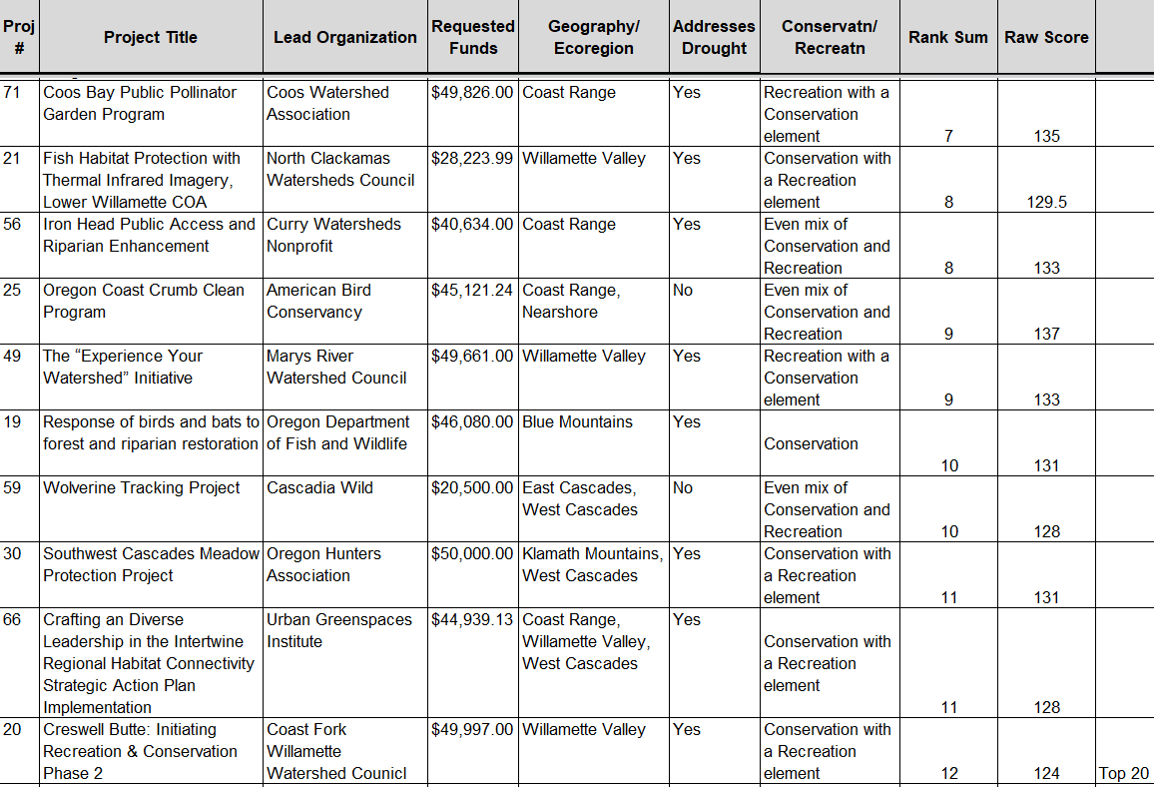
Top 20 ranked

Slide 7
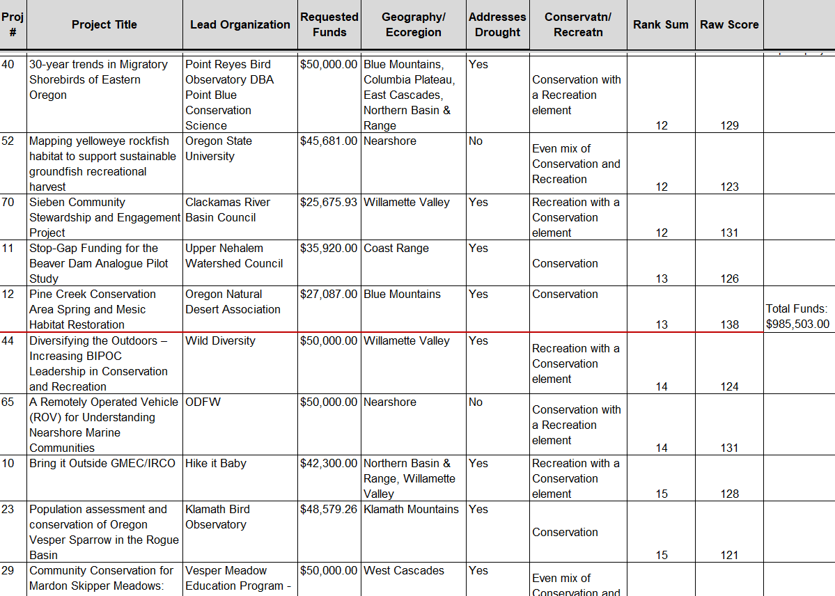
Top 25 ranked

Slide 8
Projects that Address Drought
TOP 25 PROJECTS: Drought –Related Focus
Project Addresses Drought? | Top 25 Ranking
Yes | 21
No | 4

Slide 9
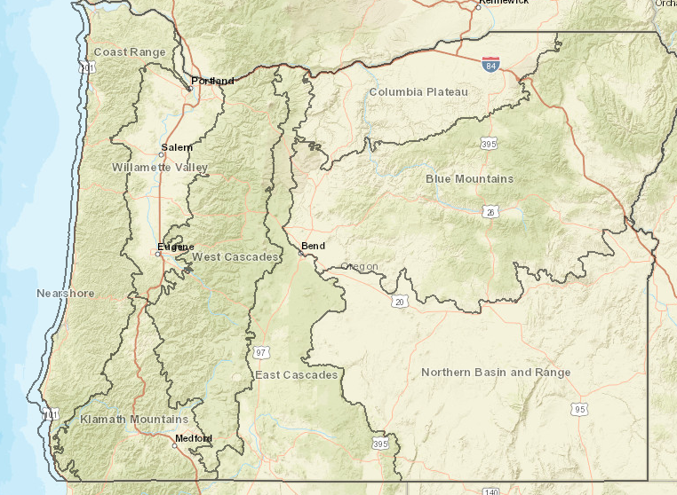
Projects by Ecoregion
Ecoregion | Proposed | Top 25 Ranking
Nearshore | 11 | 2
Coast Range | 16 | 5
W. Valley | 23 | 10
Klamath Mtn | 8 | 2
West Cascades | 13 | 5
East Cascades | 14 | 4
Col. Plateau | 7 | 4
Blue Mtn | 13 | 7
N. Basin/Range | 6 | 2

Slide 10
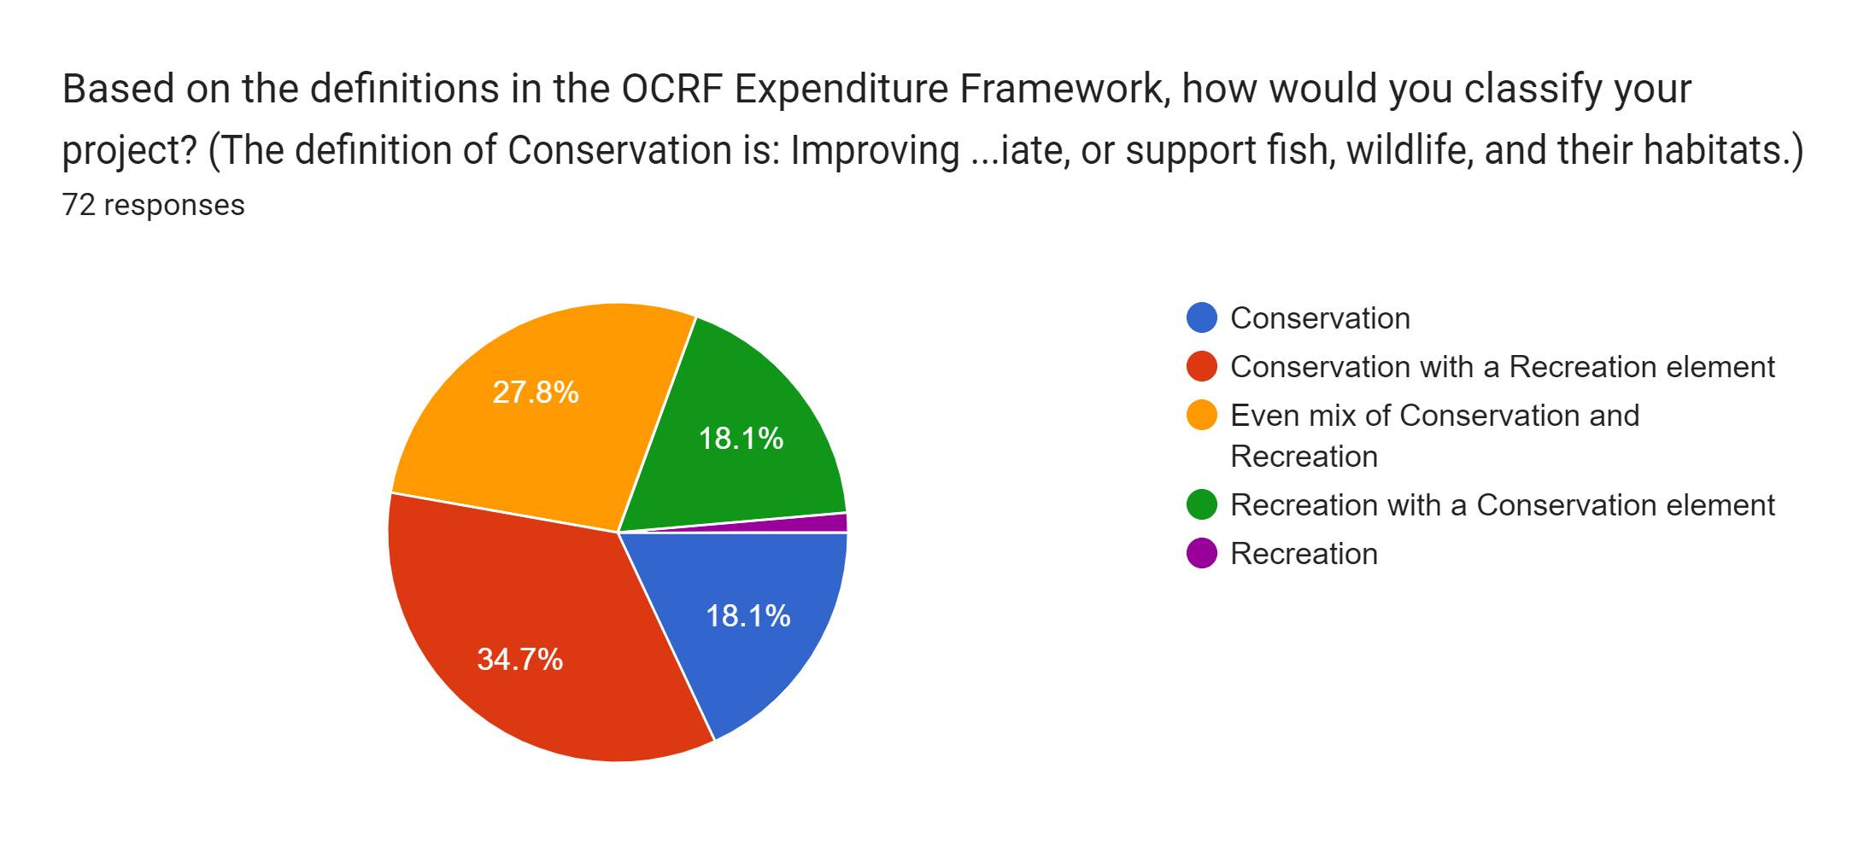
Projects by Conservation/Recreation
Out of 69 Proposed Projects

Slide 11
Projects by Conservation/Recreation
TOP 25 PROJECTS: Conservation versus Recreation Element
Conservation/Recreation Element | Top 25 Ranking
Conservation | 5
Conservation with a Recreation element | 11
Even mix of Conservation and Recreation | 4
Recreation with a Conservation element | 5
Recreation | 0

Slide 12
Draft Motion: Recommended Projects
I move to approve the top 25 OCRF Winter 2023 Projects from the Ranked Project List, totaling $985,503 in total funds.
I move to approve the top 25 OCRF Winter 2023 Projects from the Ranked Project List, with the following changes: _____ totaling $___,____ in total funds.

Slide 13
OCRF RFP Timeline - Winter 2023
Request for Proposals (RFP) – Opened January 30th, 2023
1st Informational Session – February 17th, 2023
(Recording posted on website)
2nd Informational Session – March 10th, 2023
Will be similar format to previous informational
Week of Reminder of grant closure – March 20th, 20223
Request for Proposals (RFP) – Closes March 27th, 2023
Technical Review Deadline: May 15th, 2023
OCRF Advisory Committee Review Deadline: May 31st, 2023
OCRF Advisory Committee Recommendations – June 5th, 2022
ODFW Commission Voting – June 16th, 2023
Release of funds following contracting process – August 2023

Slide 14
Agenda Item 3:
OCRF Legislative Update

Slide 15
Agenda Item 4:
Break
(Please be back in 5min)

Slide 16
Agenda Item 5:
Public Comment

Slide 17
Agenda Item 6:
OCRF Budget and Logistics Update

Slide 18
Budget Status after Current RFP
Fund | Original Allocation | Obligated (incl. current RFP) | Remainder
OCRF Base Program (incl. donations, carry fwd) | $1.8M | $1.8M | $250K
2022 Drought Funds (HB 5006; 2021) | $5M | $2.5M | $2.5M
ARPA – Federal (HB 5202, 2022) | $1M | $1M | 0
Other (held by Oregon Wildlife Foundation): Oregon is Alive ~ $74,000; Fishawk Lake Mitigation ~ $900,000

Slide 19
HB 5006 – ODFW Budget 23-25, still pending
POP 112 Oregon Conservation and Recreation Fund
Statewide Drought Package provides $1M General Fund for deposit into OCRF specifically for drought related projects
Expenditure limitation provided
Makes permanent one existing, limited duration, full-time NRS-3 (1.00 FTE) to serve as the OCRF Coordinator
HB 2999 – Wildlife Connectivity
Potentially included in Statewide Drought Package
Would deposit $5M to carry out projects to support wildlife mobility and habitat connectivity within priority corridors identified in OCAMP

Slide 20
OCRF 2023 Work Plan
Temp position through June 30, 2023
Permanent position awaiting legislative approval – Oct 2023 (?)
Administrative Rules Revision (Oct or Dec 2023)
Increasing transparency around grant review process and criteria
Special projects
Alignment with Private Forest Accord OARs
Paused Fall RFP to allow for Strategic Planning:
Monitoring & Performance Measurement of OCRF Program
Communications Strategy
Fundraising

Slide 21
Agenda Item 7:
The Way Forward for the OCRF

